Slide 1
Magenic Masters React Flux
Feb 14, 2017
Tim Chan

Slide 2
Agenda
Flux
Dispatcher
Store
Action

Slide 3

Flux
An application architecture where data flows in one direction.

Slide 4
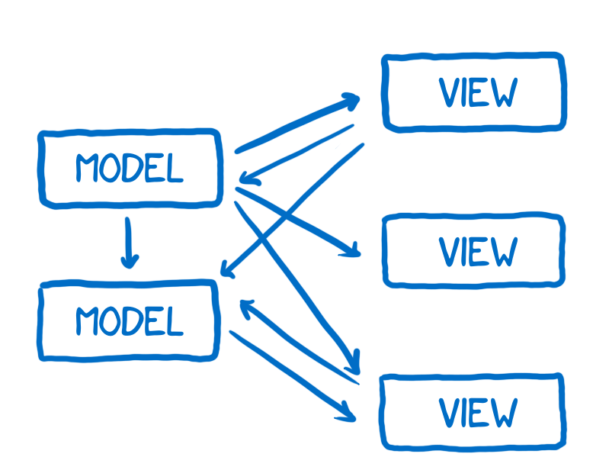
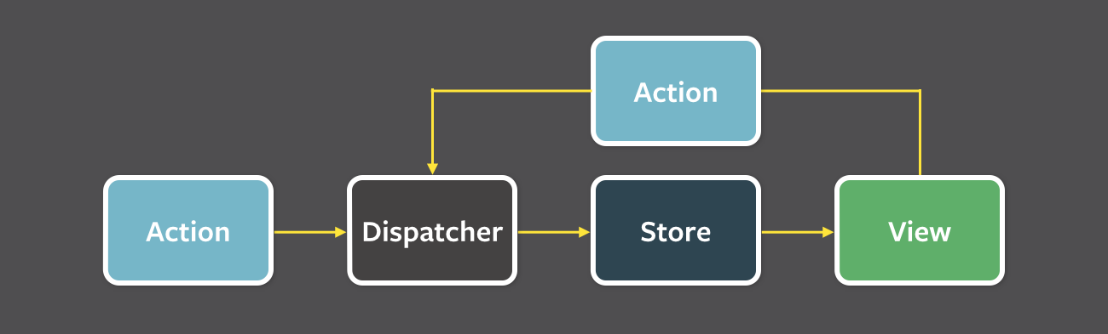
The Flux solution

Slide 5
Flow of Data
Views send Actions to the Dispatcher
The Dispatcher sends actions to every Store
Stores send data to the Views

Slide 6
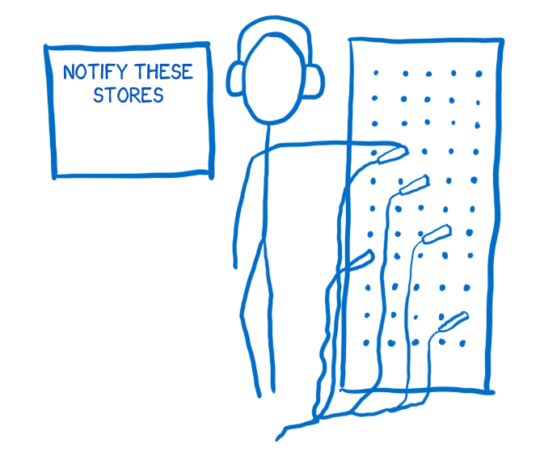
Dispatcher
Receives actions and dispatches them to stores
Every store will receive every action
Only one singleton dispatcher in each application

Slide 7
Facebook Dispatcher API
register(function callback): string
Registers a callback to be invoked with every dispatched payload. Returns a token that can be used with waitFor().
unregister(string id): void
Removes a callback based on its token.
waitFor(array<string> ids): void
Waits for the callbacks specified to be invoked before continuing execution of the current callback. This method should only be used by a callback in response to a dispatched payload.

Slide 8
Facebook Dispatcher API
dispatch(object payload): void
Dispatches a payload to all registered callbacks.
isDispatching():Boolean
Tells if Dispatcher is currently dispatching

Slide 9

Store
Holds the data of an application
Registers with the application’s dispatcher so it can receive actions
Data in a store must only be mutated by responding to an action
Every time a store’s data changes, it must emit a “change” event

Slide 10

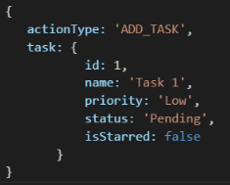
Action
Simple objects that have a “type” field and some data
Action Creators – helper function to create and dispatch an action

Slide 11
Demo

Slide 12
Bonus Question: +1 in final grade
What issue did I introduce in the TaskList component? How do I fix it?

Slide 13
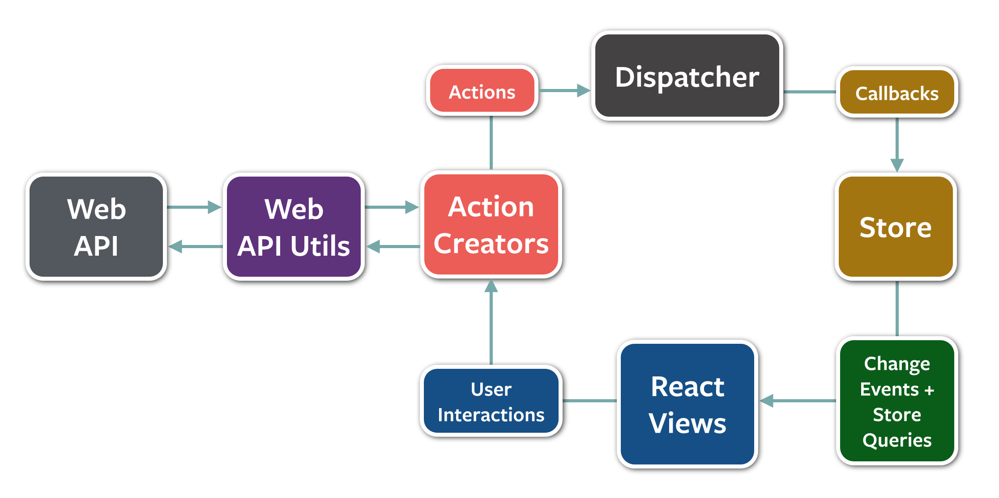
Recap

Slide 14
Credits
Facebook Flux Page http://facebook.github.io/flux/docs/overview.html#content
Cartoon Guide to Flux https://code-cartoons.com/a-cartoon-guide-to-flux-6157355ab207#.g3w00xeji

Slide 15

Questions?

Slide 16
Next session…
Quiz
Assignment #5
Deadline: Assignment #4 EOD Thursday

